Slide 1
Drilling Deep
Automatic Security Testing for JavaScript Sandboxes
Abdullah AlHamdan | Webinar @GIKI | Feb 2025

Slide 2










Security Isolation
A security foundation aims to enable the computing systems to be resilient to a set of security threats.
Separates entities and provides configurable capabilities.
Physical/Virtual
Threads
Policy
Notes:
Before getting into the details, let us review the concept of security isolation. [CLICK]
Security isolation is a security foundation to empower the resiliency of computing systems against array of attacks[CLICK]
These attacks might differ from an entity to another, however, security isolation separates these entities and provides controlled way of communication[CLICK]
Types of security isolation can be classified in [CLICK] Physical or virtual isolation [CLICK] running them on different threads, [CLICK] or, having a policy where it controls the interaction. [CLICK]

Slide 3
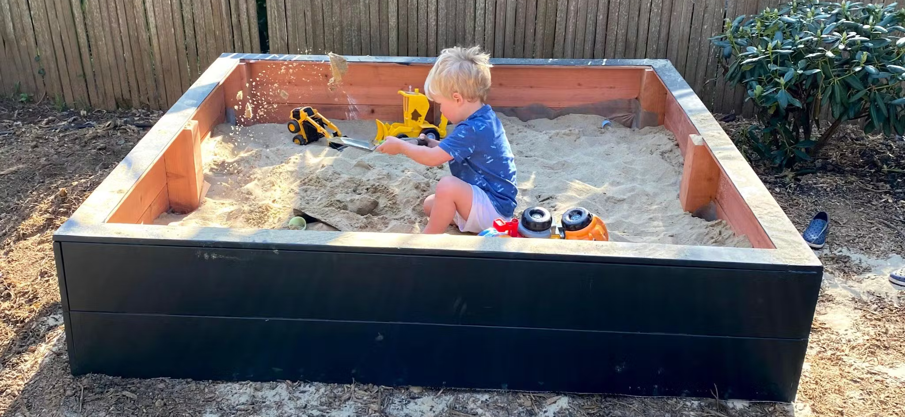

Slide 4

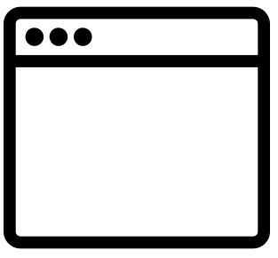


What is a Sandbox?
Form of security mechanism for isolation
Running programs (OS-Level).
Third party source code (Source code level).
OS level
Language Level
Notes:
SandBox is a security mechanism to enable isolation. It consists of 2 main types. The first one is on the operating system level: [CLICK] assuming we have 2 running programs on an OS, and one of them is a malicious application.
Security isolation will prevent the operating system and the other running apps to interact with it. [CLICK] while Language level sandboxes are working on the code itself. So we can perform more specific isolation. [CLICK]

Slide 5
What is a JavaScript Sandbox?
It limits the capabilities of the third-party or untrusted code:
Limits the access to the global object and the built in functions
Offers a way to share references between the guest code and host code via endowments
1: const sandBox = require("realms-shim"); 2: const realm = sandBox.makeRootRealm(); 3: realm.evaluate( 4: `log("foo");` 5: , {log : console.log} 6: );
Endowments
Running code with endowments on a sandbox.
Notes:
Language based sandbox limits the capabilities of the guest code from accessing the global object and the built-in functions of the host environment. Since it is necessary for the guest code in some cases to access built-in functions for example, [CLICK] the sandbox allows the guest code to call them by endowments, []

Slide 6




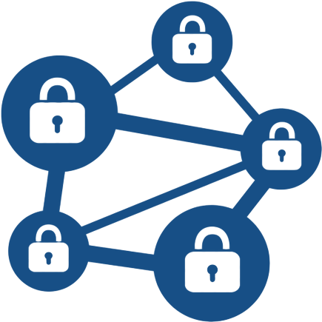

Motivation
JavaScript is widely-used in security-critical scenarios
It provides cheap security solution
Scarcity of testing JavaScript sandboxes, especially the server-side
Malware Analysis:
Box-js
Intel owl
Cloud
Zscaler
IoT
NodeRED
Moddable XS
Blockchain Embark

Slide 7

Now wait a second… how can we test language security features?!

Slide 8




Study of Isolation Solutions for JavaScript
Read sandboxes documentation
Study the sandboxes vulnerabilities/fixes
Understand the sandboxes’ capabilities
Audit sandboxes’ source code
Notes:
To move on with our research, we first had [CLICK] a look at the sandboxes documentations what they offer and what are the best practices.. [CLICK] then we studied the available sandboxes vulnerabilities and how the maintainers fixed them… [CLICK] we get our hands dirty to understand the sandboxes capabilities … [CLICK] and finally we audit sandboxes source code locally for better understanding. [CLICK]

Slide 9




Security Objectives
SO1: Prevent read/write outside
SO2: Restrict accessing privileged operations
SO3: Prevent blocking the main loop
SO4: Prevent host process crash
Notes:
During the study of the JavaScript sandboxes, we came with 4 main security objectives, so the good sandbox shall prevent unprivileged read and write outside the sandbox … [CLICK] it also shall restrict calling privileged operations into the sandbox … [CLICK] prevent blocking the main loop of the host code. … and [CLICK] prevent hard crashes on the host process. [CLICK]

Slide 10
Study of Isolation Solutions for JavaScript )Cont.(
S: server-side sandbox C: client-side sandbox
Notes:
Based on our study, we managed to cluster the sandboxes into two main types [CLICK] the Runtime based sandbox, and the Language based sandbox which is out main interest in this paper. [CLICK] however, we have noticed that higher number of language based sandboxes has the ability to work on both client side and the server side. [CLICK] despite the fact that language based sandboxes are interested in tackling the first and the second security objectives only.

Slide 11
Threats to Language-Based Sandbox
Sandbox escape via prototype chain gives the access to foreign references
global
.__proto__
.__proto__
require
proc
.__proto__
require
let x
Main Program
Sandbox
Notes:
The most dangerous threat to the sandboxes is the one which tries to violate the second security objective, the Sandbox escape through prototype chain could give access to foreign references. To explain this attack [CLICK] assume we have a main program, [CLICK] hosting guest code in a sandbox. [CLICK], with moving up in the prototype chain, [CLICK] the last point in it might remain inside the sandbox, which indicates good sandboxing. [CLICK] or unfortunately it ends up with escaping the sandbox which by means [CLICK] accessing the fully privileged global object of the main program… [CLICK] accessing the global object in JavaScript means also accessing powerful APIs such as [CLICK] require API.. [CLICK] which will lead in the end to create type of call channel between the guest code and the main program through a vulnerable sandbox by the prototype chain. [CLICK]

Slide 12



SANDDRILLER
Detect security violations to security objectives
Can be integrated in the development process of Language-Based Sandboxes
1st approach to test language-based sandboxes
Uses dynamic analysis
12
Notes:
So here we propose SandDriller, [CLICK]

Slide 13






Methodology
1x instrumented
+
Nx variants
Status of the analysis
Instrumentor: injects oracles to the seed code
Seed Code
Instrument and Generate
Run on Sandbox
Results
Valid source code
Test Cases
Generator: generates new variants from the given seed code
Testing oracles search for foreign references.
Notes:
Our methodology starts with [CLICK] a seed code, [CLICK] which is self-contained JavaScript code.. [CLICK] instrumentation and generation [CLICK] the instrumentor injects test oracles into the seed code [CLICK] while the generator increases the amount of tests by generating new tests based on the seed code..which means [CLICK] we expect having [CLICK] one instrumented copy of the seed code and number of variants.. [CLICK] we run these tests in the sandbox so we hope finding vulnerabilities .. [CLICK] and after SandDriller finishes all the test cases, we have the results. In this presentation, we put the focus on instrumentation process, and all rest of the methodology are available on the paper, During the instrumentation face [CLICK]

Slide 14
Seed corpus
Contains self-contained JavaScript code,
It should cover most of the language’s features,
V8 unit tests and ECMAScript tests (Test262).
Standard API
Built-in functions/objects
Function definition
1: function foo() {
2: 3: try { 4: throw "bar"; 5: } finally { 6: return "baz"; 7: } 8:} 9: 10: foo(); 11: print({});
1: const p = eval("import('./module-code_FIXTURE.js');");
2: 3: assert.sameValue(Object.getPrototypeOf(p), Promise.prototype , \
'prototype is %PromisePrototype%’); 4: 5: p.then(imported => { 6: assert.sameValue(imported.default, 42); 7: assert.sameValue(imported.indirect, 'Test262’); 8: }).then($DONE, $DONE);
Throw/Exceptions
try, catch, finally
Function invocation
Arrow functions
Empty object
V8
ECMA
Can be found in:
v8/api-call-after-bypassed-exception.js
Can be found in:
ECMA/language/expressions/dynamic-import/usage-from-eval.js

Slide 15

Instrumentation
Injects code that tests all potential foreign references.
i.e., global scope, function invocation, function entrance, try .. catch clause, throw, exceptions, this … etc.
Analysis function(s)
Global object/variables
function analysis(){ ... }
analysis(global); analysis(variables); const p = analysis(eval("import('./foo');"));
analysis(p.then(imported => {
analysis(this); analysis(arguments); analysis(foo(imported)) }));
const p = eval("import(‘./foo');"); p.then(imported => { foo(imported) });
Simplified
ECMA/language/expressions/dynamic-import/usage-from-eval.js
Function invocation
Function entrance
Notes:
We take input code from the corpus and [CLICK] inject oracles to test all potential foreign references [CLICK] .. These points might be [CLICK] .. [CLICK] .. [CLICK] .. And [CLICK] to for sure we add the analysis functions at the top of the instrumented seed code. [CLICK]

Slide 16
Variants Generation
Injects hard-to-handle patterns from previous sandbox breakouts function entrance.
#variations = #function definitions
try { function foo() { throw function thrower() { return () => { return this; }; }(); ... return "foo"; } foo(); } catch (e) { analysis(this); analysis(e); }
function foo() {
... return ”foo"; }
function bar() {
... return ”bar"; } foo(); bar();
From existing exploits
try { function bar() { throw function thrower() { return () => { return this; }; }(); ... return ”bar"; } bar(); } catch (e) { analysis(this); analysis(e); }
Seed file
Notes:
The variant generator aims to inject-to-handle patterns by the sandbox inside the seed test case. We inspired these patterns from the already existed exploits.. [CLICK] to goal of this generator is to inject these patterns on each function entrance, therefore the number of variants depends on the the number of function definitions.

Slide 17
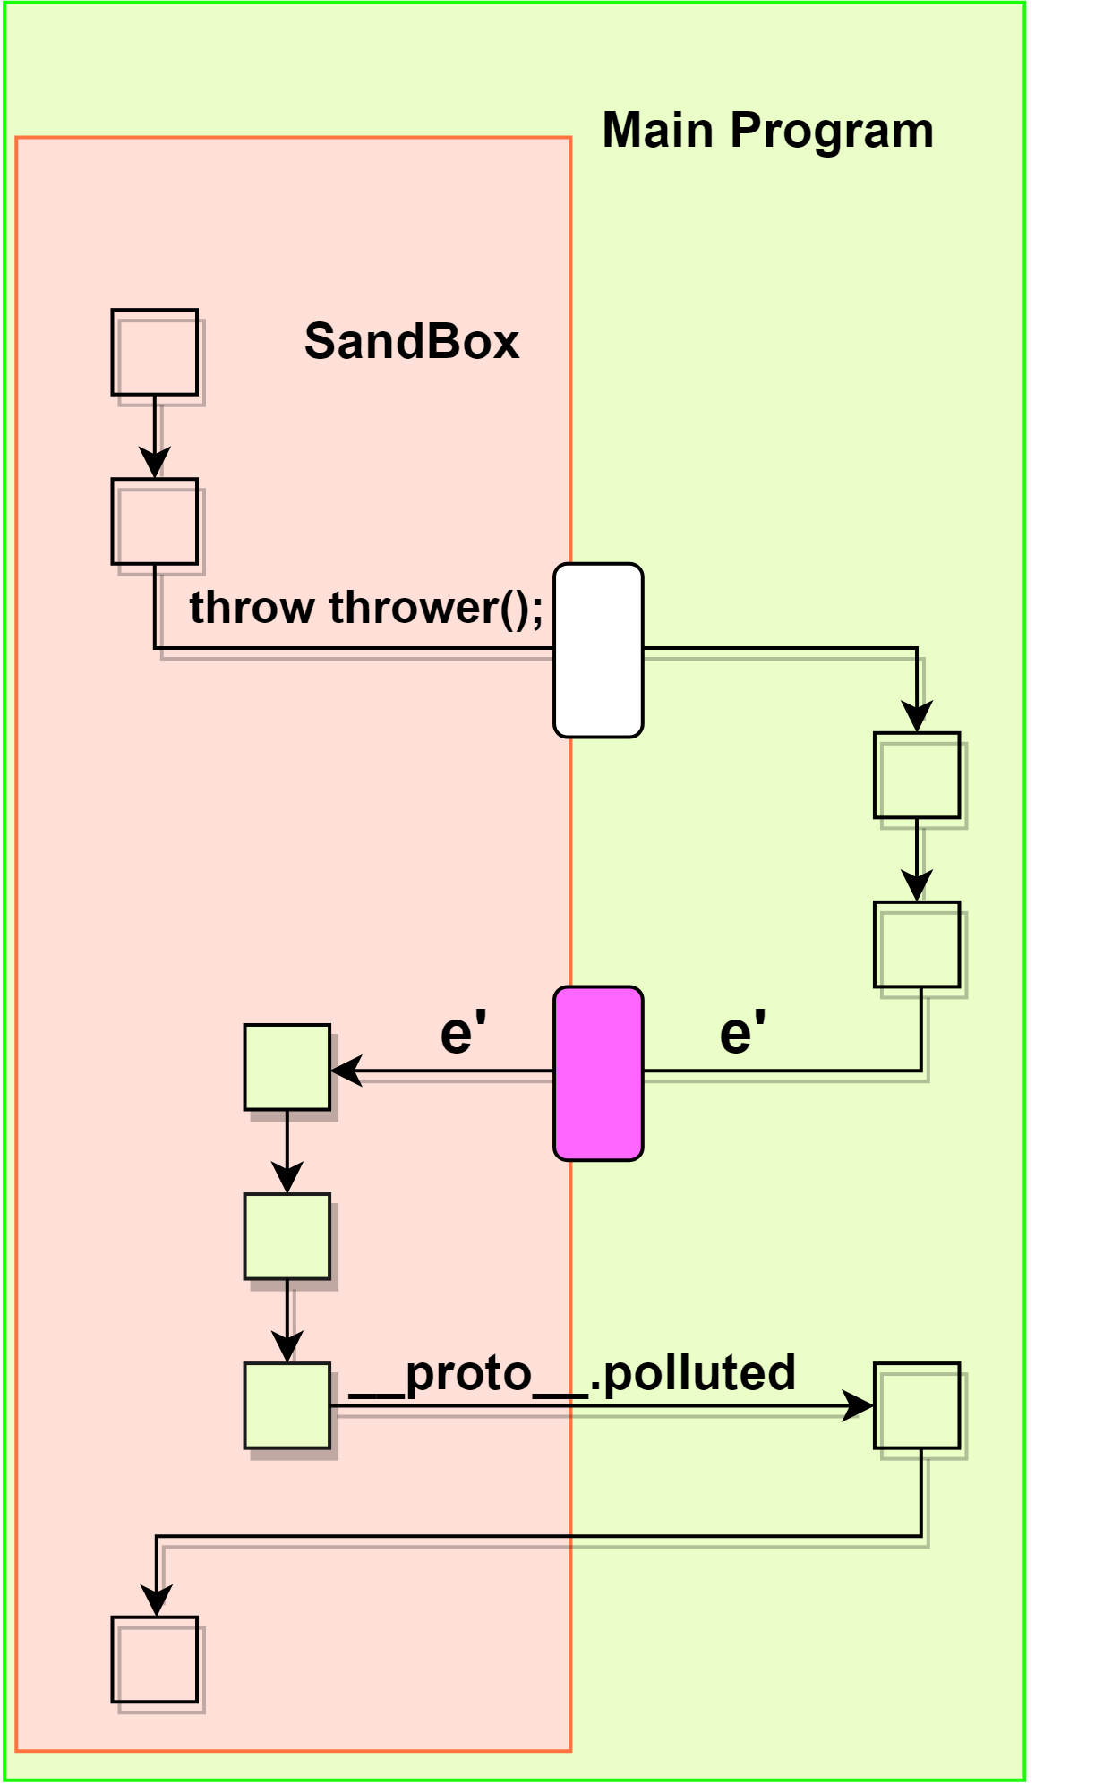

Variants Generation
Exceptions from functions internals might not be wrapped
try { function foo() { throw function thrower() { return () => { return this; }; }(); ... return "foo"; } foo(); } catch (e) { analysis(this); analysis(e); }

Slide 18
Sandbox runner
Runs multiple tests at once using a multi-process architecture
A fresh process for each test seed in pool of processes
Respawns processes when a hard crash is detected.
Main Program
.__proto__
G
G
.__proto__
New process
New process
Instrumented test
Instrumented test
Main Program
Server side sandbox
Web Browser
client side sandbox
Testing server side sandboxes
Testing client side sandboxes
Notes:
[note on the variant] From the existing exploits

Slide 19



Oracle Checks
To test two main objectives of Language-Based Isolation:
Read/Write secret flag
Access/Call powerful API
Detect hard crash

Slide 20
Oracle Checks
To test two main objectives of Language-Based Isolation
Writing outside the sandbox.
Unprivileged read/require.
function getRootPrototype(obj){ while (obj.__proto__) { obj = obj.__proto__; } return obj; } let root = getRootPrototype(v); write(root); requireExternal(root);
1: sandbox.run(instrumented_Code); 2: console.log({}.polluted);
3: checkRequireExternal();
Instrumented seed code
Oracle checks outside the sandbox
Notes:
The oracle checks aims to test the two main objectives of the language based sandboxes, writing outside the sandbox, and the unprivileged read/call. To test writing outside the sandbox, we included a secret flag in our analysis code during the instrumentation process… [CLICK] so we can read it out side the sandbox if a write attempt is successful… [CLICK] and we test the other objective by having successful call from outside the sandbox to inside the sandbox .. Such as require API [CLICK].

Slide 21
Sandbox Runner Cont.
Errors types
No Error | Runtime Error | Instrumentation Error | Security Error | Timeout | Hard crash | Memory Violation
Results and Logging
Seed Name | Tested Sandbox | Time Execution | Number of Oracle Checks | Instrumentation Error | Run Error | Security Error | Number of Variants

Slide 22

Experimental Setup
Notes:
Now we move to building our experiments [CLICK]

Slide 23






Experimental Setup
2X Seed corpus
ECMAScript (41034)
v8 (5572)
2X Test rounds
With and without
the variants generator
3X Node.js versions
14.15, 15.12, 16.12
Server-side
Client-side
vm2, realms-shim, ses
safe-eval, near-membrane
AdSafe
Notes:
To have more comprehensive experiments, we used [CLICK] 3 different nodeJS versions, with [CLICK] 2 different seed corpus to insure that we cover the language features as possible. We also run the same experiments twice, one without the varients generator, and one with it. [CLICK] we also tested server side sandboxes , [CLICK] and client side sandboxes. [CLICK]

Slide 24
Quantitative Results
Results of testing the sandboxes using SANDDRILLER across the selected Node.js versions
Notes:
As a result of our experiments, we start with the Quantitative results,,, For table size issues, I am presenting 2 of the 3 node versions results[CLICK],,, based on the numbers and the inspection of the security errors, we can say that sandboxes are more prone to security violations whenever it runs with newer versions, this can be explained by the lack of covering new to more New language specifications.[CLICK] and as we can see here, newer nodeJS versions are more robust to sandbox’s crashes. [CLICK] and unfortunately, the hard-to-handle patterns are still causing troubles to the new versions. And finally [CLICK] the better sandbox is the better isolation strategy. [CLICK]
.
New language specifications
More robust versions
Exception handling issues
Weak vs. Strong isolation

Slide 25
Quantitative Results Cont.
9X CVEs
Results of testing the sandboxes using SANDDRILLER across the selected Node.js versions
Notes:
This follow up table shows the total number of all results across the 3 node versions.. And In the end, we managed to minimize the troublesome tests with delta debug ging and we successfully had [CLICK] 9CVEs [CLICK]

Slide 26
Qualitative Analysis: CVE-2021-23449
VM2 < 3.9.4
'ERR_UNHANDLED_REJECTION'
1: let code = ` 2: p = eval('import("kscx");'); 3: p.__proto__.__proto__.polluted = 'polluted'; 4: `; 5: const {VM} = require("vm2"); 6: let vmInstance = new VM(); 7: vmInstance.run(code); 8: console.log(polluted); // output: 'polluted'
Exploit the prototype chain
Write outside the Sandbox
Notes:
Here I am showing 2 CVEs, the first one targeted VM2 sandbox, the most popular JavaScript sandbox, and as you can see [CLICK] on line 2, the guest code attempts to execute a powerful API through privileged eval by VM2. This caused an execution outside the sandbox, which SandDriller [CLICK] exploited to successfully write outside the sandbox [CLICK] as you can see on line 8. [CLICK]

Slide 27
Qualitative Analysis Cont.: CVE-2021-23594
Realms-shim =< 1.2.2
1: let realm = Realm.makeRootRealm(); 2: try { 3: realm.evaluate(`Error.prepareStackTrace=
4: function(error, stackTrace){
5: stackTrace.__proto__.__proto__.polluted = "success";
6: }; x;` ); 7: } catch(e) { 8: } 9: console.log(polluted); // output: 'success'
'ERR_UNHANDLED_REJECTION'
DEPRECATED
Writing outside through error stack
Notes:
Another Zeroday which we successfully found was against realms-shim, This zeroday exploits [CLICK] the javascript error stack to escape outside the sandbox.. [CLICK] in this example we showed it can write outside, but also it can be used to deliver more dangerous attacks, such as command execution.. Which put the authors of realms-shim to [CLICK] stop supporting this package since the problem is by sandbox design. [CLICK]

Slide 28
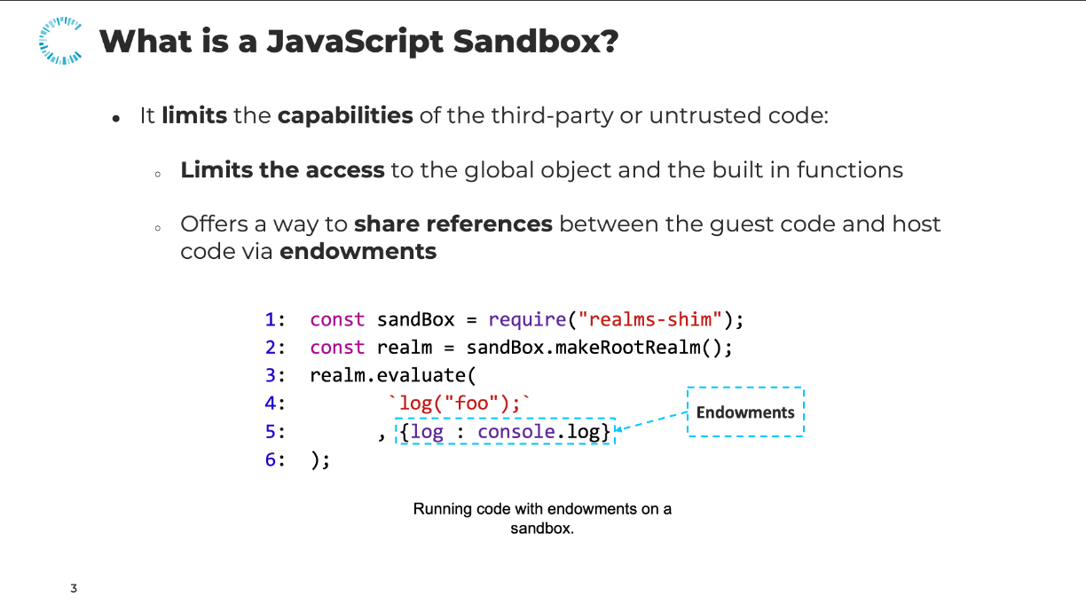
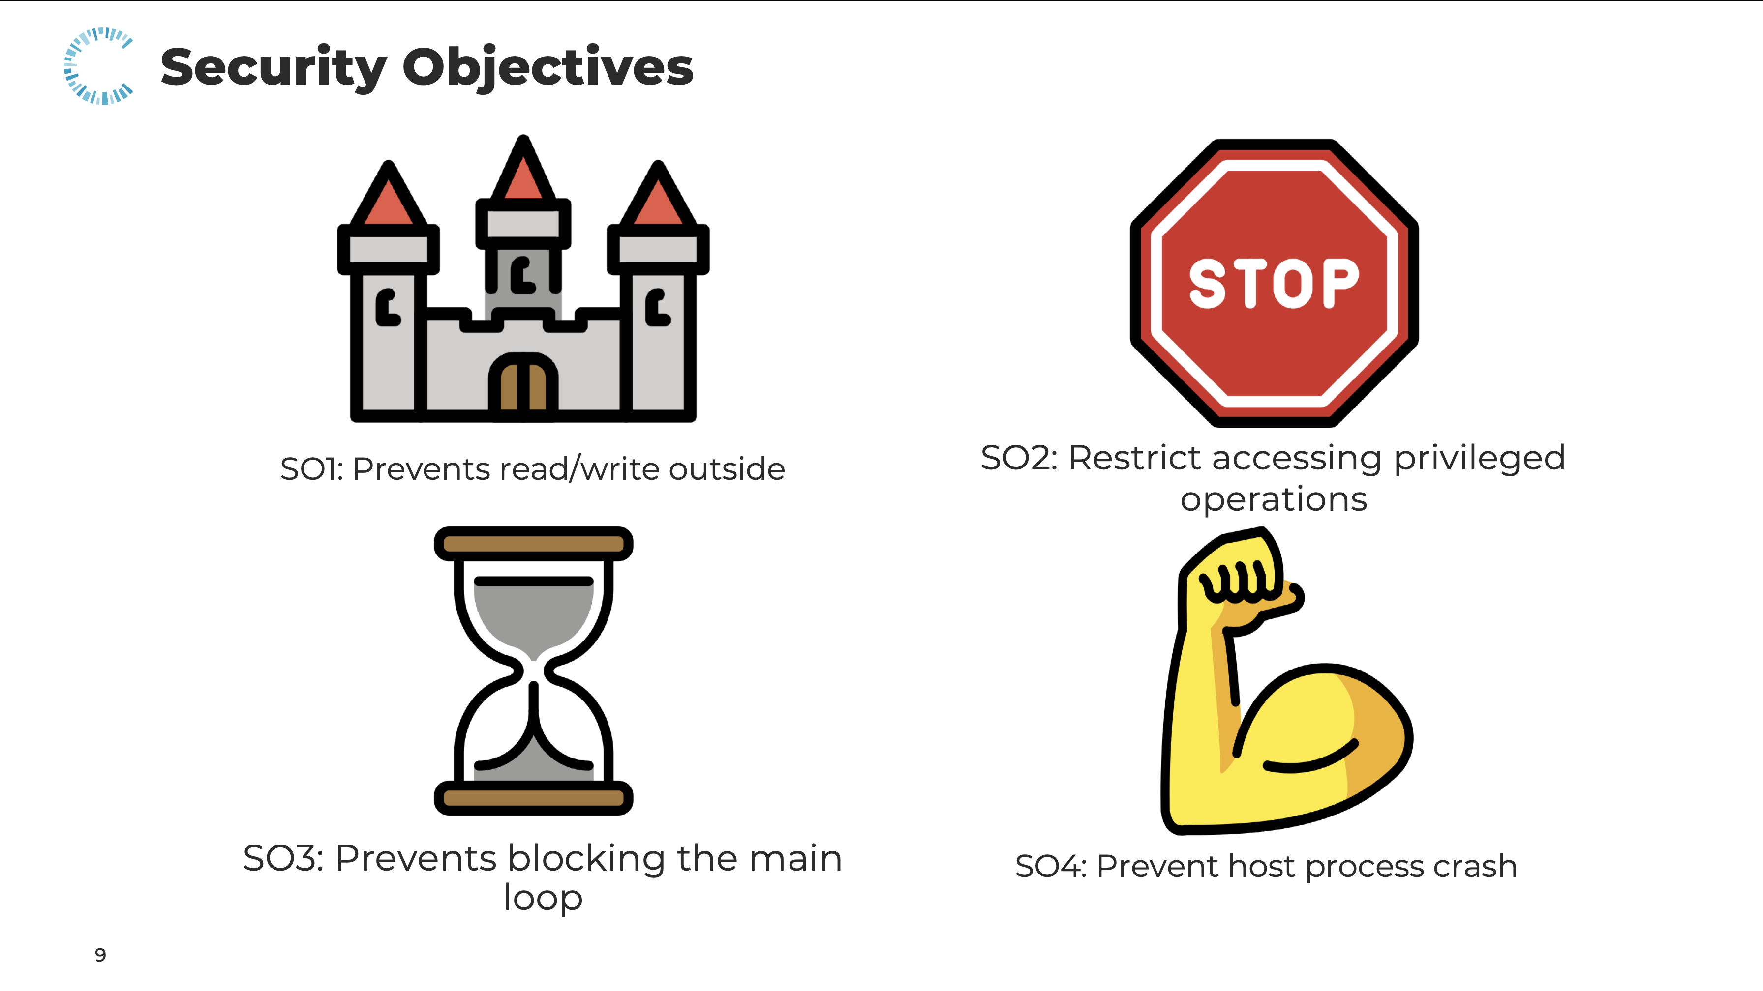
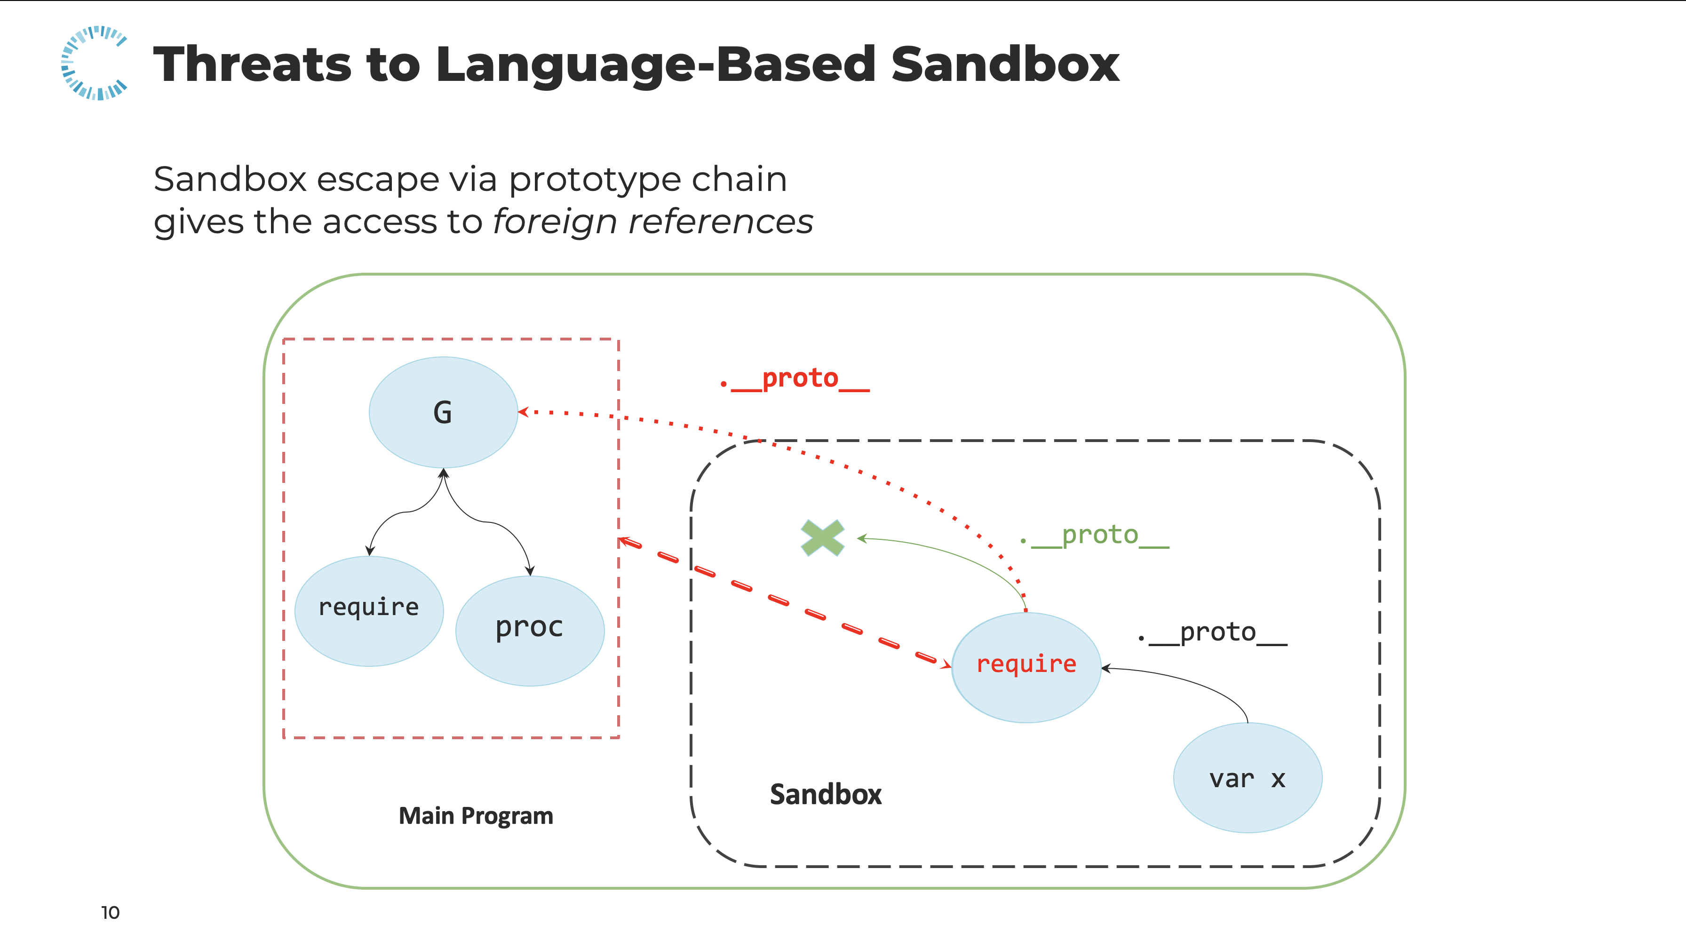
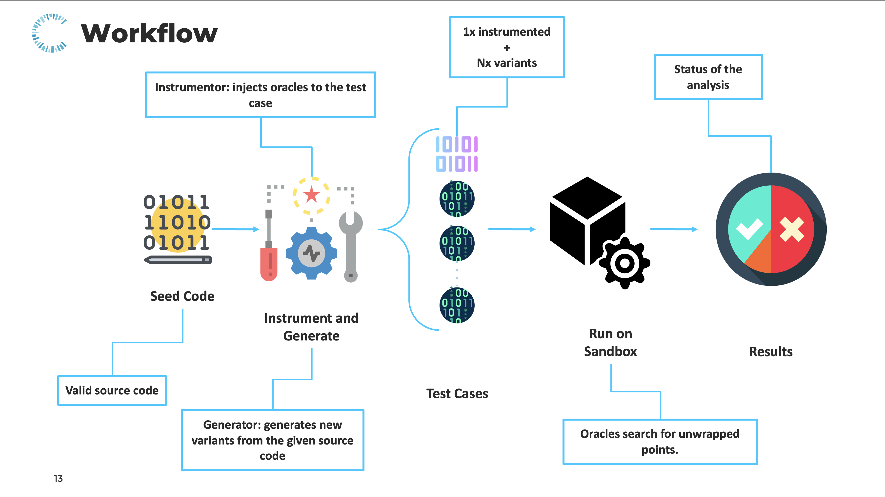
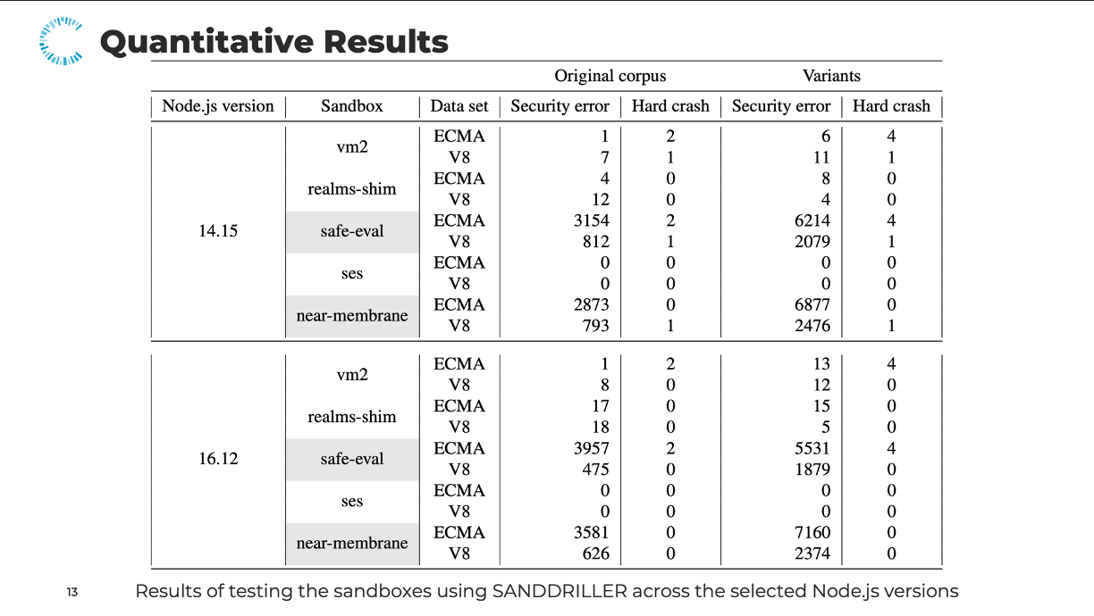
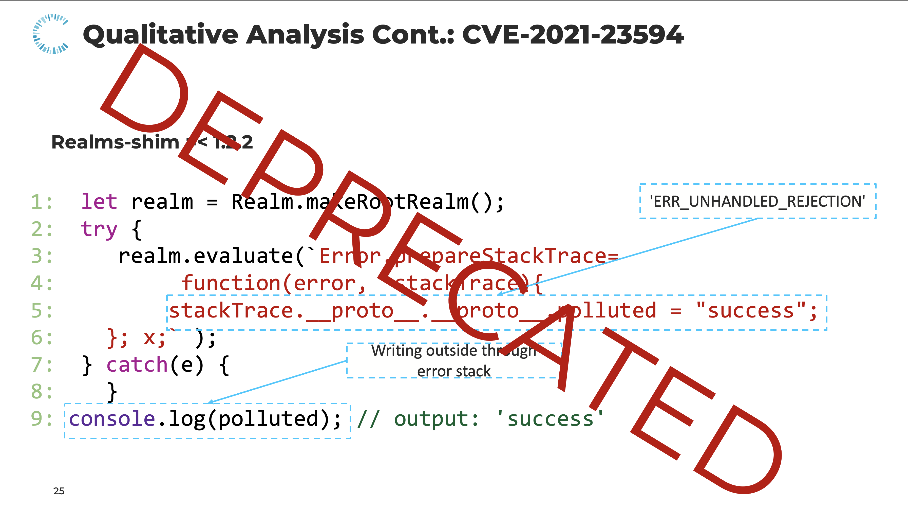



Conclusions
@AbdullahMHamdan
SandDriller’s source code
abdullah.alhamdan@cispa.de
Notes:
Finally, we showed [CLICK] the concept of isolation in general, [CLICK] we came up with what sandboxes have to do after we studied them, [CLICK] we also explained a sandbox escape attack by prototype chain [CLICK] we explained how SandDriller works, last but not least we showed interesting Quantitative [CLICK] and [CLICK] Qualitative results.. Thank you all, I am happy to take your questions!

Slide 29
Exploit Minimization: Delta Debugging
Failure-inducing circumstances
Inputs, code, execution
Possible failure cause
Set up 1st hypothesis
Test 1st hypothesis
Minimal lines-of-code which triggers the same problem!
Vulnerability sink!
2nd hypothesis
3th hypothesis
4th hypothesis
Notes:
Since instrumentation requires adding more lines of code to detect possible vulnerabilities, we used delta debugging to get the minimal working exploit. Delta debugging is a mechanism to detect the root cause of a failure in a program, it starts with indicating [CLICK] a possible failure cause, [CLICK] set the first hypothesis by deleting unnecessary lines of code to have the same failure, [CLICK] test the hypothesis.. And iterate the same {CLICK while talking} steps with further hypothesis until reaching the minimal working code that causes the exact failure.. Which is in our case: the exploit.

Slide 30
Seed corpus
Contains self-contained JavaScript code,
It should cover most of the language’s features.
Function definition
1: function foo() { 2: try { 3: throw "bar"; 4: } finally { 5: return "baz"; 6: } 7:} 8: foo(); 9: print({});
Throw/Exceptions
try, catch, finally
Function invocation
Empty object
A v8 test
And more…
Can be found in:
v8/api-call-after-bypassed-exception.js
Notes:
Zooming in the methodology, Seed corpus should be set of self contained JavaScript code, and since we are testing language based sandboxes, it is highly recommended to have a seed corpus which covers the language features as much as possible. Such as [CLICK] .. [CLICK] .. [CLICK] .. [CLICK] .. [CLICK] .. [CLICK] and More .. [CLICK].

Slide 31
Sandbox runner
Runs multiple tests at once using a multi-process architecture,
A fresh process for each test seed in pool of processes,
Respawns processes when a hard crash is detected.
Errors types
No Error | Runtime Error | Instrumentation Error | Security Error | Timeout | Hard crash | Memory Violation
Results and Logging
Seed Name | Tested Sandbox | Time Execution | Number of Oracle Checks | Instrumentation Error | Run Error | Security Error | Number of Variants
Notes:
Our sandbox runner executes multiple tests at a time based its multi-process architecture. When it takes a new test to run, a fresh process is spawned from the pool of processes. The sandbox runner can respawn processes when a hard crash is detected too. On top of that, the sandbox runner reports several error types and numerous types of results which might be interesting in finding bugs.

Slide 32
Quantitative Results
New language specifications
More robust versions
Exception handling issues
Weak vs. Strong isolation
Results of testing the sandboxes using SANDDRILLER across the selected Node.js versions
Notes:
New language specifications
More robust versions
Exception handling issues
Weak vs. Strong isolation

